Slide 1
Memory and FSMs

Slide 2
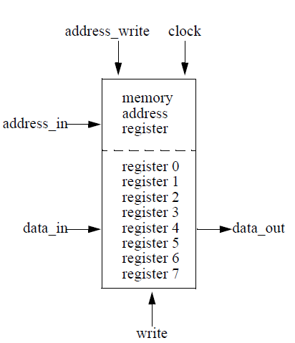
Steps to write memory?

Slide 3
Back to counter
Recall the counter we built.
  What is it’s “state?”
Now consider counter that repeats part of the sequence
  0, 1, 1, 2, 2, 2, (forever 2)
  Now what is the state?

Slide 4
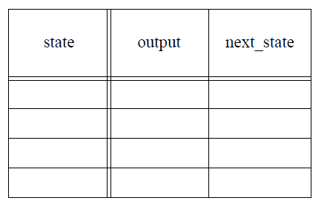
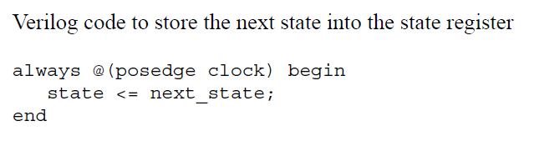
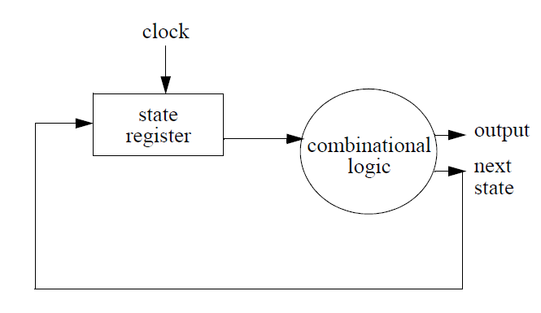

Slide 5
always @* begin
case (state)
2’h0: begin
end
2’h1: begin
end
2’h2: begin
end
2’h3: begin
end
endcase
end

Slide 6
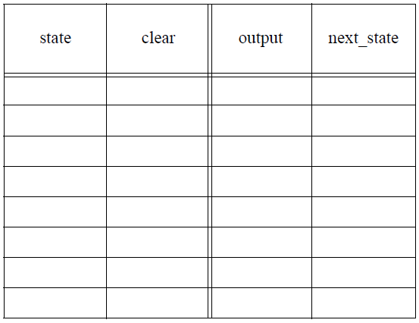
Circuit with input
Count as before
• 0, 1, 1, 2, 2, 2, ...
  But if clear==1 and you’re printing 2, then start back at 0

Slide 7
